Slide 1

“Can I become a developer (WEB)?” JavaScript Chat Application
Dev: Kristiyan Petsanov
Mentor: Nadezhda Manchevska

Slide 2
Content
“Can I become a developer?” – Slide 3
What libraries/tools were used in the development process? – Slide 4
What is the point of the application? – Slide 5
How can you access the app? – Slide 6
Application Overview – Slide 7-12
Live Demonstration – Slide 13
Conclusion – Slide 14

Slide 3
Can I become a developer?
One of the most common question that a future developer can ask themselves
Focus on the first two words
Anyone can become a developer if they are motivated, can put up the time required and of course a laptop/computer.
There is one rule you must not break if you want to become a developer – You mustn't quit!
If you don’t have the ability to learn a programming language at school, you can always take courses online.
YOU CAN DO IT!

Slide 4
Libraries And Tools
FireBase was used to handle the back-end of the application
Page.js was used for the routing throughout the SPA
lit-html was used for rendering HTML templates
Webpack was used for bundling the modules/libraries into one file

Slide 5
What is the point of the application?
The point of the app is to show what you can do with just 2 months of studying how to create a JS application and basic knowledge of HTML and CSS.
In just 2 months you can learn how to make and end-to-end application with all the features that your everyday app has such as user profile, profile customization etc.
That’s exactly what I’ve done in the chat app. You can make your own account; you can create your own chats and invite your friends/co-workers by giving them the name and the password of your chat.

Slide 6
How can you access the app?
Link 1: https://kristiyanpts.github.io/chatApp/
Link 2: https://chat-app-22f2e.web.app/

Slide 7
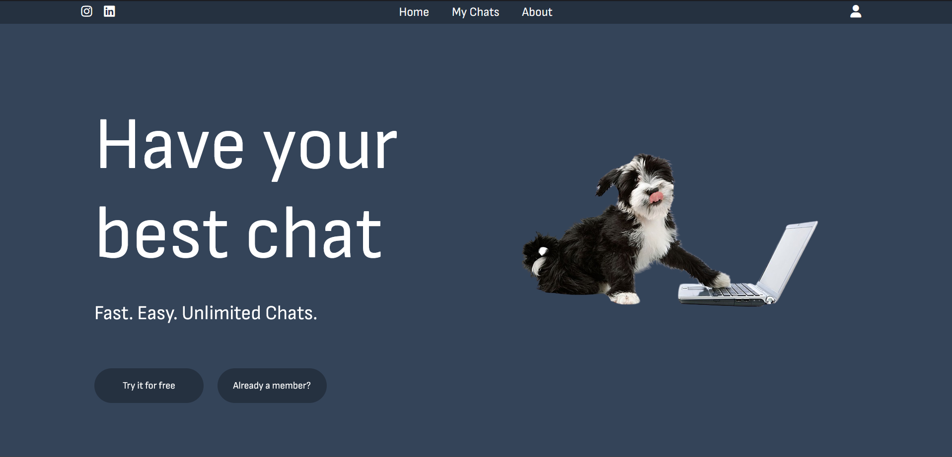
App overview – Home Page

Slide 8
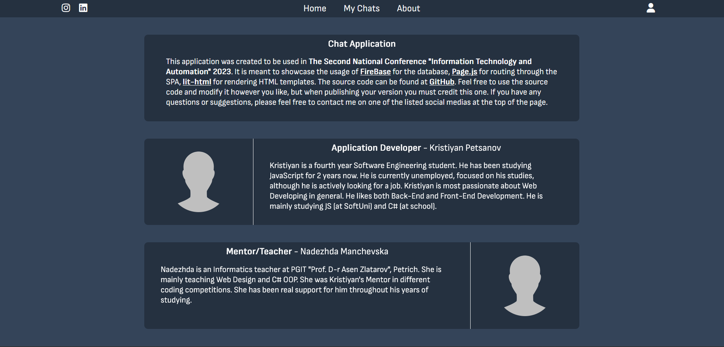
App overview – About Page

Slide 9
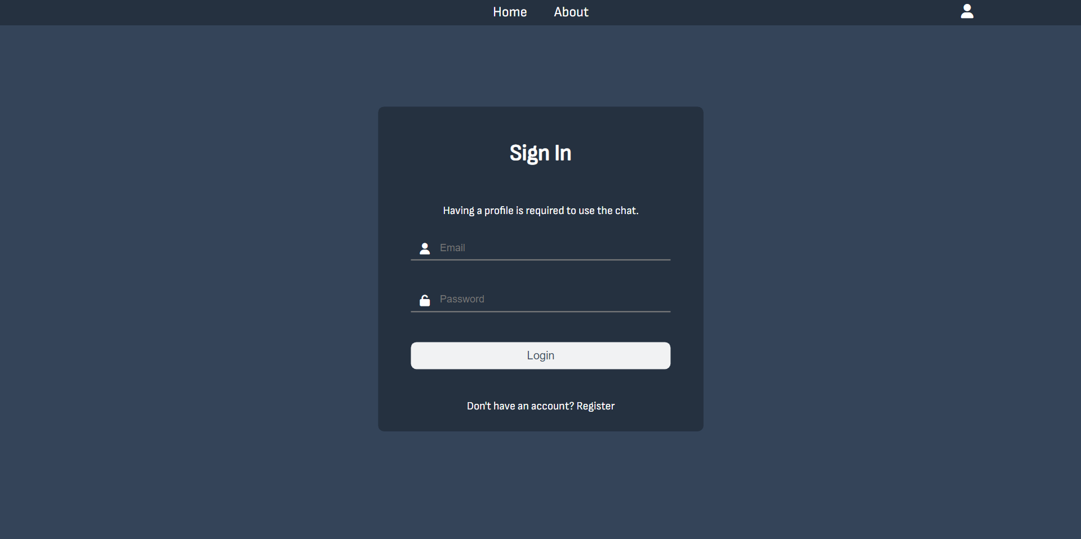
App overview – Sign In Page

Slide 10
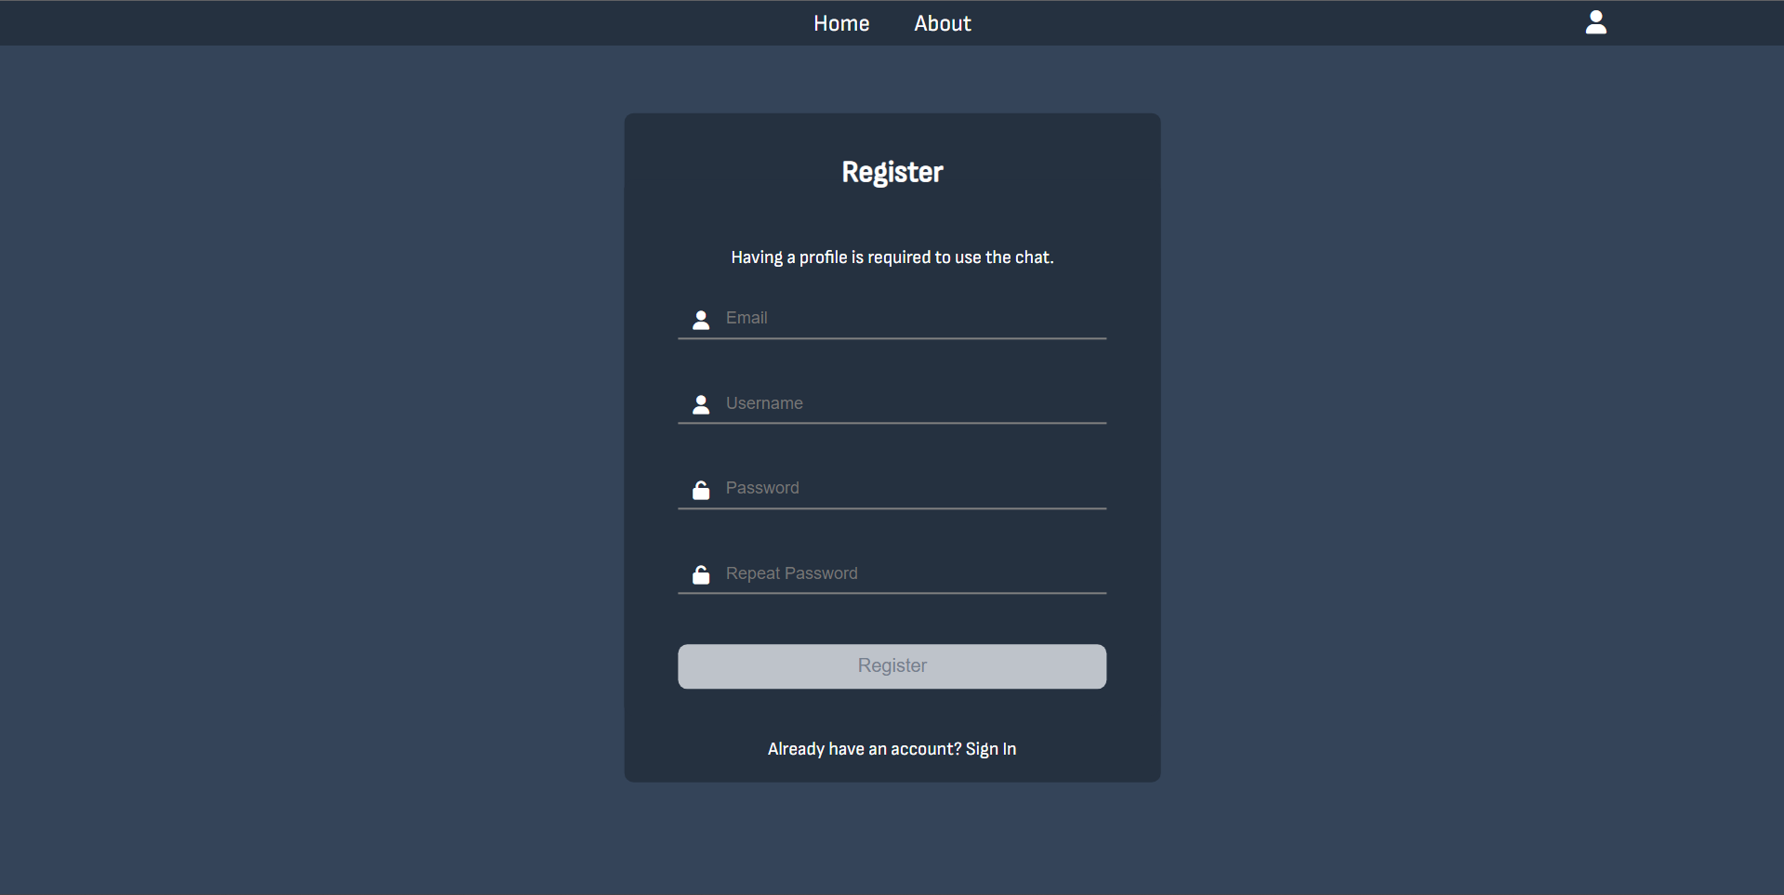
App overview – Register Page

Slide 11
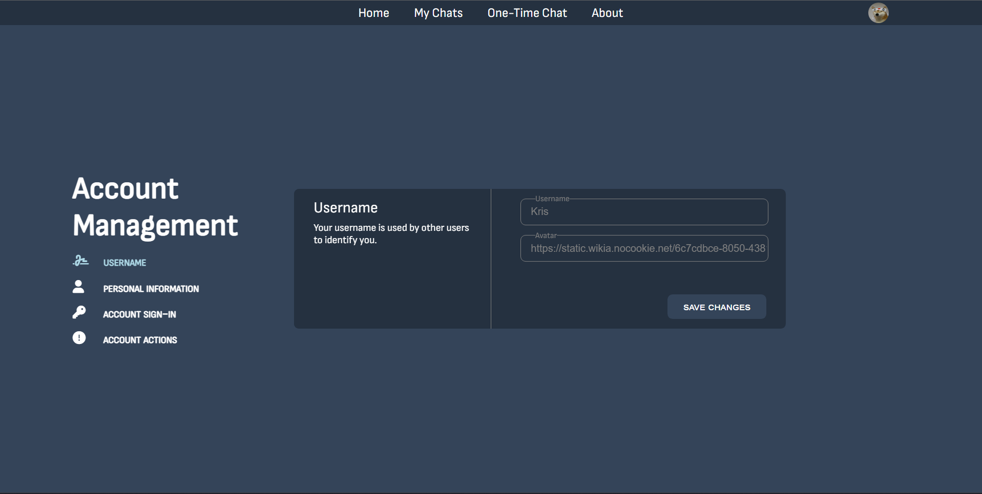
App overview – Settings Page

Slide 12
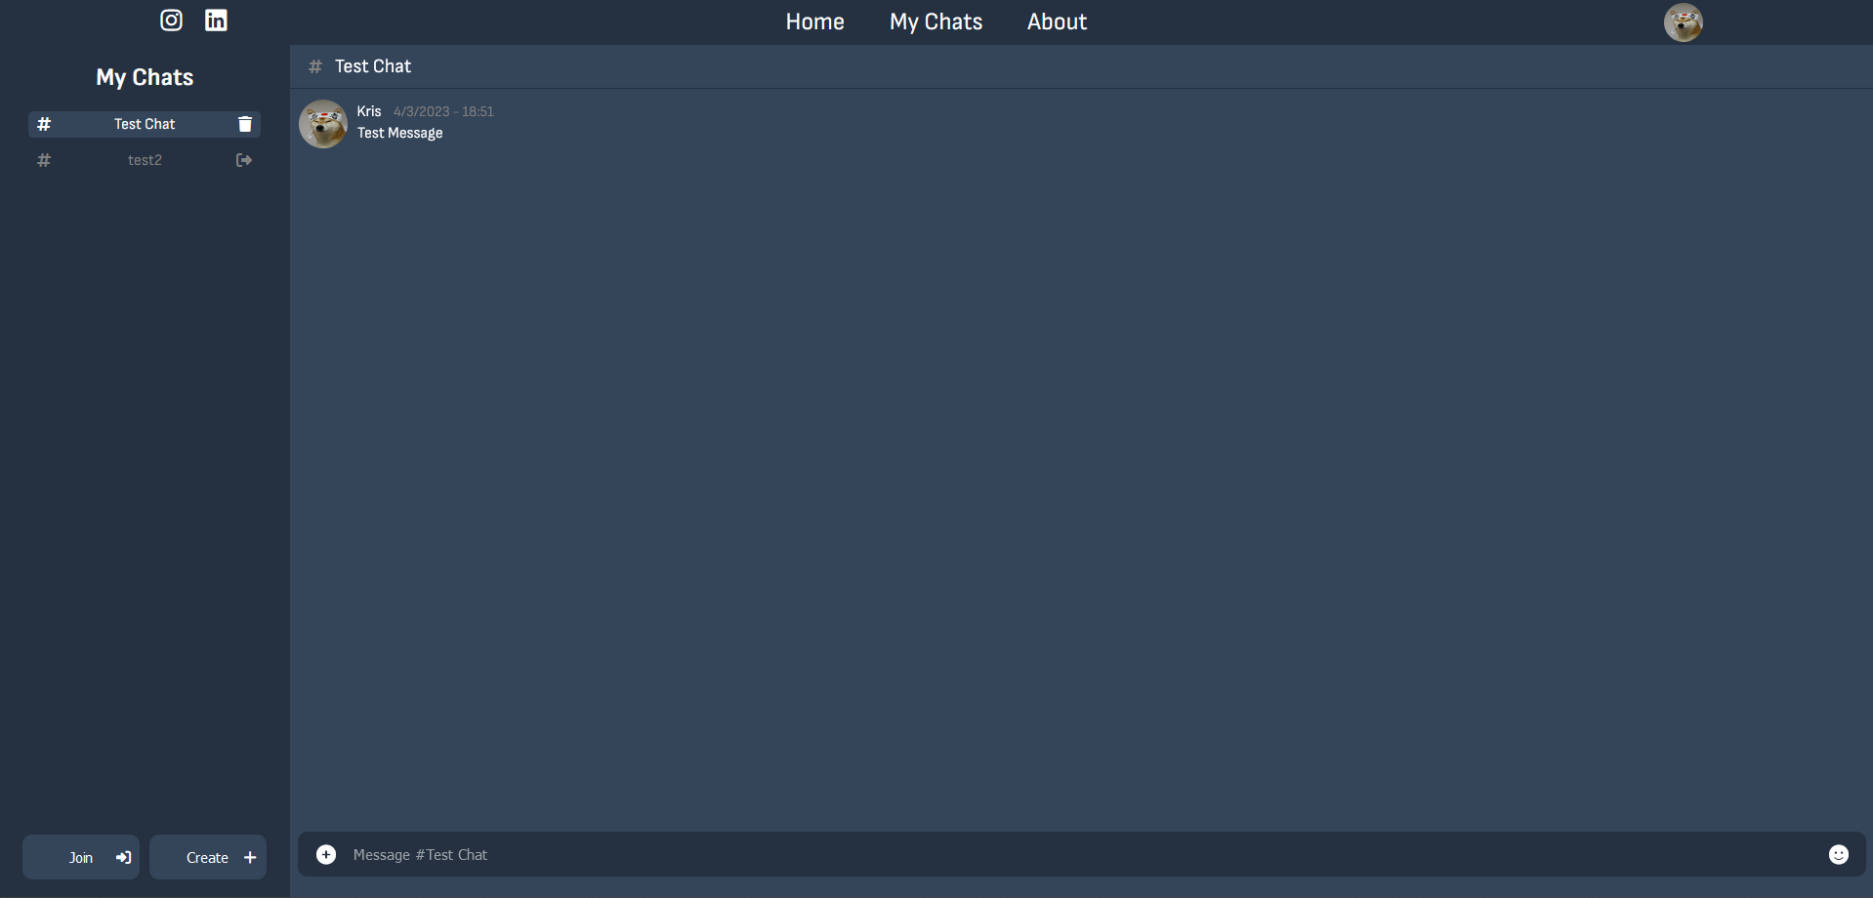
App overview – Chats Page

Slide 13
Live Demonstration https://kristiyanpts.github.io/chatApp/

Slide 14
Conclusion
Learning JS or any other language may seem hard, but it is like everything else. It will be hard in the beginning; however, it will be worth in the end.
If you are wondering whether to start studying any programming language or not, I suggest you start learning it, follow your dreams and NEVER Give Up.
Start coding today! ☺

Slide 15
Thank you for your attention!

